Slide 1
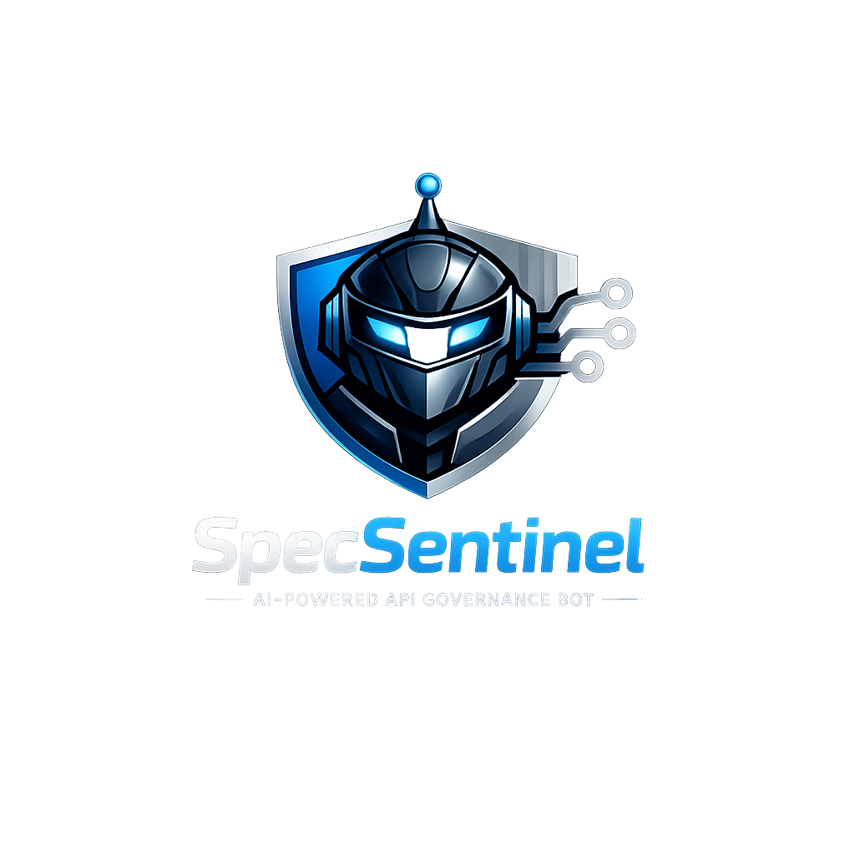
SpecSentinel
PRESENTED BY
DATE
Team Sentinel :
Debapriyo Dasgupta
Niveed Kumar Reddy Bollapally
April 2026
Notes:
Slide 1 — Title (0:00–0:20)
Good afternoon, everyone. We are Team Sentinel — Debapriyo Dasgupta and Niveed Kumar Reddy Bollapally— and today we're presenting SpecSentinel: an autonomous, agentic API governance engine built powered by AI (IBM watsonx.ai).
What makes SpecSentinel different from every other API linter or validation tool out there? It doesn't just check rules. It thinks, plans, and acts — like a senior security architect running a full review, except it does it in under 10 seconds.

Slide 2
Table of Content
Problem Statement
MVP Implementation Scope
Solution Design & Architecture
Business Value/Impact
Future Enhancements/Implementation Scope
Demo
Closing note
Notes:
Slide 2 — [Transition] (0:20–0:30)
Before we get into the solution, let's talk about the problem that inspired it.

Slide 3
Problem Statement
Business problem
Business Problem
Why it matters
IBM watsonx.ai
Enterprises expose 100s of APIs
The cost of API insecurity is measurable
OpenAPI specs are the contract — but they routinely ship without security schemes, error handling, or governance standards. Ungoverned APIs become attack surfaces, integration failures, and compliance liabilities.
Breaches via exposed APIs average $3.8M per incident. OWASP ranks broken API security in its Top 10 every year. Poor spec quality compounds every downstream integration, review cycle, and production risk.
~ $4M
57%
100s of APIs
avg. cost per API breach incident
of orgs hit by an API breach (last 2 yrs)
reviewed manually — slow & inconsistent
Current challenges
IBM product in scope
No security schemes
WX.ai
IBM watsonx.ai
OAuth2, JWT, scopes absent — endpoints ship unprotected
Foundation model for agentic reasoning
Missing critical response codes
401, 403, 429 undocumented — blind spots in error handling
Powers SpecSentinel to:
Inconsistent errors & REST violations
· Dynamically plan validation rules
No reusable schemas, poor versioning and naming conventions
· Reason over spec findings & risks
No continuous governance
· Generate fix-ready YAML guidance
Standards drift silently — no OWASP / ISO alignment at design time
· Score & project maturity improvements
Without automated governance, every new API is a liability waiting to be discovered.
COE Automation Hackathon 2026
Confidential - Internal Use Only
Notes:
Slide 3 — Problem Statement (0:30–1:20)
Enterprises today expose hundreds of APIs. OpenAPI specifications are the contract that governs them — but in practice, these specs routinely ship without security schemes, proper error handling, or governance standards. The numbers are stark: The average cost of an API breach is more than $4 million per incident (as per IBM Cost of a Data Breach Report 2025).
57% of organizations have experienced an API breach in the last two years.
And yet, API reviews today are largely manual — slow, inconsistent, and impossible to scale.
Common failures we see: missing OAuth2 or JWT authentication, undocumented 401 and 403 error responses, inconsistent naming conventions, and zero alignment with OWASP or ISO standards.
The result? Every ungoverned API that ships becomes a liability waiting to be discovered in production.

Slide 4
MVP Implementation Scope
What SpecSentinel MVP delivers
Categorize
Recommend
Plan
Analyze
Categorize
Recommend
Score
Improve
An autonomous agentic bot that ingests OpenAPI 3.x specifications (YAML/JSON) and executes a closed-loop governance cycle — Plan → Analyze → Categorize → Recommend → Score → Improve — producing a structured API Health Report with zero manual effort.
Autonomous closed-loop — no manual intervention required
Input: OpenAPI 3.x YAML / JSON · Output: Structured API Health Report + JSON export
Key features
Key features
Security analysis
API design checks
Threat classification
✦
◈
▲
Detects missing OAuth2, JWT, API Key schemes. Flags absent 401/403/429 responses and sensitive schema exposure.
Validates REST method usage, versioning strategy, operationId presence, naming conventions and pagination.
Every finding rated Critical / High / Medium / Low and mapped to Security, Design, Operational or Governance risk.
✎
Fix recommendations
≡
Benchmark alignment
◉
Health score engine
Issue description, risk rationale, remediation steps and ready-to-use YAML/JSON snippet for every finding.
Maps findings to OWASP API Top 10, OpenAPI best practices and ISO governance. Shows compliance % per standard.
Computes 0–100 score across 5 weighted categories. Maps result to Poor / Moderate / Good / Excellent bands.
Target Users
API developers & architects
Security & governance teams
Enterprise architects
Get instant spec feedback and fix-ready YAML before code ships to production
Enforce OWASP, OpenAPI and ISO standards consistently across all API teams
Track API health scores as a KPI and drive structured modernisation programmes
MVP success criterion: accept a real OpenAPI spec → classify threats → score maturity → generate actionable fixes → demonstrate the agentic loop.
COE Automation Hackathon 2026
Confidential - Internal Use Only
Notes:
Slide 4 — MVP Implementation Scope (1:20–2:10)
This is exactly what SpecSentinel solves. But let me be specific about how — because the approach is fundamentally agentic, not just automated.
Traditional tools apply static rules. SpecSentinel deploys a closed-loop agentic cycle powered by WatsonX AI:
Plan → Analyze → Categorize → Recommend → Score → Improve
At each stage, the AI agent doesn't just execute a fixed script — it reasons about the spec context, decides which governance rules are relevant, and generates tailored fix guidance.
It's the difference between a spell-checker and a co-author. No manual intervention. No human reviewer. Just a structured API Health Report produced through genuine agentic reasoning — in seconds.
Concretely, SpecSentinel delivers 6 core capabilities:
Security analysis — detects missing auth schemes, absent error codes, and sensitive data exposure.
API design checks — validates REST conventions, versioning, naming, and pagination.
Threat classification — every finding is rated Critical, High, Medium, or Low, and mapped to a risk category.
Fix recommendation — Proper issue description with risk identification and remediation steps
Benchmark alignment — maps findings to OWASP API Top 10, OpenAPI best practices, and ISO governance standards.
Health scoring — a 0-to-100 score across five weighted dimensions, giving teams a single measurable KPI.
The success criterion for our MVP was simple: ingest a real OpenAPI spec, classify threats, score it, and generate actionable, fix-ready YAML — and we've demonstrated that end-to-end.

Slide 5
Solution Design & Architecture
OpenAPI 3.x spec · YAML / JSON
UI layer
Web frontend
REST API client
Flask + HTML/JS · browser upload interface
curl / Postman · HTTP/JSON programmatic access
Back- end
FastAPI server
POST /analyze · POST /analyze/text · GET /health · GET /stats · POST /refresh
Engine layer
Signal extractor
Rule matcher
Health scorer
Report gen.
50+ signals
Vector search · ChromaDB
0–100 weighted
JSON / text
Vector DB
ChromaDB
Security · 10 rules
Rule ingest
Web scraper
Scheduler
Cosine similarity Persistent storage Auto-refresh
Design · 8 rules
OWASP Top 10 OpenAPI · RFC 7807
Weekly auto-refresh Manual trigger
Errors / Docs / Gov · 4+3+4
AI layer
Universal AI agent
watsonx.ai
Orchestrator
Security
Design
Error handling
Documents
Governance
Multi-LLM · explanations auto-generated fixes
Parallel exec. result aggregation
Final output · Enhanced health report
Health score · findings · AI explanations · fix code · agent insights · JSON export
COE Automation Hackathon 2026
Confidential - Internal Use Only
Notes:
Slide 5 — Solution Design & Architecture (2:10–3:00)
Here's how it works under the hood.
At the UI layer, users can upload specs via a Flask web frontend or call the REST API directly with curl or Postman.
Requests hit a FastAPI backend that coordinates with the engine layer — a pipeline of four components: a signal extractor that parses 50+ signals from the spec, a rule matcher using vector search against ChromaDB, a health scorer, and a report generator.
The vector database holds over 29 governance rules across security, design, error handling, documentation, and governance categories — sourced from OWASP, OpenAPI standards, and RFC 7807. A built-in web scraper auto-refreshes these rules on a weekly schedule (which can be configured to daily or even hourly).
And at the top sits our AI layer — the brain of SpecSentinel — powered by IBM watsonx.ai.
This layer has two key components.
First, a Universal AI Agent with multi-LLM support that auto-generates human-readable explanations and fix-ready code for every finding. It doesn't just flag a problem — it tells you why it's a risk and exactly how to fix it.
Second, an Orchestrator that coordinates five specialized sub-agents running in parallel — each one a domain expert in its own right:
The Security agent brings OWASP API Top 10 expertise.
The Design agent enforces REST best practices.
The Error Handling agent checks RFC 7807 compliance.
The Documents agent evaluates documentation quality.
And the Governance agent ensures alignment with enterprise standards.
The Orchestrator fans out the work across all five agents simultaneously, then aggregates their results into one coherent, prioritized health report. This is what makes SpecSentinel truly agentic — not a single model answering a single question, but a coordinated multi-agent system delivering comprehensive insights across every dimension of your API spec.

Slide 6
Business Value/Impact
95% faster
98% cheaper
2-3x more
API review time (4-8 hrs → 5-10 min)
Cost per review ($400-800 → $5-10)
Security issues found per API
Value proposition
ROI potential
Continuous, intelligent API governance
Quantifiable returns from day one
Translates architectural policies into machine-evaluable controls
Issues are 10x cheaper to fix at design vs. production
Enforces OWASP, OpenAPI & ISO standards at design time — not post-production
Documentation quality improves from 60% to 90% complete
Autonomous Plan → Analyze → Recommend → Score loop replaces manual reviews
Standards compliance rises from 70% to 95% per review cycle
Measurable API health score as an enterprise-wide governance KPI
2-5 second automated analysis vs. 4-8 hours of manual effort
Cost savings
Reusability
80% reduction in manual review overhead
Modular, extensible, integrable by design
Instant shift-left feedback during spec authoring — before any code is written
Each engine component (extractor, matcher, scorer) usable independently
Prevents fragile API contracts reaching production — reduces integration rework
Vector DB rule collections updateable without touching analysis logic
Parallel 5-agent analysis completes in 2-3 sec vs. sequential 5-8 sec
REST API & CLI interfaces enable CI/CD and third-party tool integration
Frees architects from repetitive review cycles to focus on high-value design
AI layer is optional — system runs fully without LLM for offline environments
COE Automation Hackathon 2026
Confidential - Internal Use Only
Notes:
Slide 6 — Business Value & Impact (3:00–3:40)
The business impact is direct and measurable.
SpecSentinel reduces API review time by 95% — from 4 to 8 hours down to 5 to 10 minutes.
The cost per review drops by 98% — from hundreds of dollars to under ten. And it surfaces 2 to 3 times more security issues per API than a typical manual review.
Beyond the numbers, it's a shift-left governance model: issues flagged at spec authoring time are 10 times cheaper to fix than issues caught post-production. Documentation completeness improves from 60% to 90%, and standards compliance rises from 70% to 95% per review cycle.
The architecture is also modular — each engine component can be used independently, and the AI layer is optional, so the system runs fully offline where needed.

Slide 7
Future Enhancements/Implementation Scope
Roadmap phases:
Near-term (6-12 months)
Mid-term (12-24 months)
Long-term (24+ months)
Near-term (6-12 months)
Foundation integrations — shift-left feedback, CI/CD gates and autonomous monitoring
CI/CD integration
Near-term
Streaming analysis
Near-term
Agentic API monitoring
Near-term
Automated PR creation with inline spec fix suggestions
Real-time feedback as spec is authored — line-by-line
Autonomous agent scans live APIs on a configurable schedule
GitHub Actions / GitLab CI pipeline plugin
IDE plugin (VS Code) with inline health indicators
Detects drift vs. OpenAPI spec — flags new violations
Quality gate: block merges below health score threshold
Incremental re-analysis of only changed spec sections
Auto-emails health report to mapped stakeholders per API team
Mid-term (12-24 months)
Governance intelligence — policy dashboards, gateway integration and self-updating rule engine
Policy-as-code dashboard
Mid-term
API gateway integration
Mid-term
Agentic rule repo self-update
Mid-term
Visual governance dashboard across all APIs in the org
Runtime traffic monitoring against spec contracts
Continuously scrapes OWASP, OpenAPI, RFC & CVE for new rules
webMethods APIGateway/ API Connect / Kong / Apigee adapter layer
Evaluates, vectorises & stages rules — flags conflicts for review
Custom policy definition language for enterprise rules
Live drift detection: running API vs. OpenAPI spec
Auto-merges approved rules into ChromaDB — zero maintenance
Trend tracking: health score evolution over time
Long-term (24+ months)
Scale & intelligence — distributed infrastructure, GPU acceleration and advanced ML governance
Distributed multi-agent
Long-term
Advanced ML governance
Long-term
Horizontally scaled agent cluster for large API estates
Fine-tuned LLM on enterprise API corpus for deep insights
Distributed ChromaDB — millions of governance rules
Edge deployment — offline analysis without cloud dependency
GPU-accelerated embedding generation for 10x throughput
ML-based anomaly detection across API change history
COE Automation Hackathon 2026
Confidential - Internal Use Only
Notes:
Slide 7 — Future Roadmap (3:40–4:10)
Looking ahead, our roadmap has three phases.
Near-term (6–12 months):
CI/CD integration with GitHub Actions and GitLab, quality gates that block merges below a health score threshold, and real-time IDE feedback via a VS Code plugin. Also an agentic API monitoring approach to scan highlight live APIs.
Mid-term (12–24 months): A policy-as-code governance dashboard, API gateway integration with webMethods, Kong, and Apigee, and an agentic rule engine that self-updates from OWASP and CVE feeds.
Long-term (24+ months): Distributed multi-agent infrastructure for large API estates, GPU-accelerated embedding generation, and a fine-tuned LLM on enterprise API corpora for deeper, domain-specific insights.

Slide 8
Demo
COE Automation Hackathon 2026
Confidential - Internal Use Only
Notes:
Now is the curtain raiser for the product that we have been talking about so much. Lets jump in to the live demo…

Slide 9
Thank You
The API economy is growing faster than human reviewers can keep up.
It’s time to let agents govern at agent speed.
Manual Review
SpecSentinel
✕
✓
4 – 8 Hours
VS
4-8 Seconds
Slow · Inconsistent · Unscalable
Autonomous · Intelligent · Scalable
Manual effort, inconsistent standards,
constant review bottlenecks
Agentic governance, OWASP-aligned,
zero manual effort required
SpecSentinel — Agentic Governance for the API-First Enterprise | Powered by IBM watsonx.ai
COE Automation Hackathon 2026
Confidential - Internal Use Only
Notes:
Slides 9 — Closing (4:30–5:00)
To wrap up — SpecSentinel is not just a linter. It's an agentic governance system — one that perceives your API spec, reasons about risk, takes action through five parallel specialist agents, and continuously improves through a self-updating rule engine. Powered by IBM watsonx.ai, it replaces slow, inconsistent manual reviews with an autonomous loop that scales across hundreds of APIs, enforces OWASP and ISO standards at design time, and delivers measurable ROI from day one.
And I'll leave you with this thought. The API economy isn't slowing down — enterprises are shipping more APIs, faster, across more teams than ever before. Look at what's on screen: what used to take 4 to 8 hours of manual effort, SpecSentinel does in 4-8 seconds. The answer isn't more reviewers. It's smarter agents.
The future of API governance is agentic — and that's exactly what SpecSentinel is building toward.
With this, we, Team Sentinel, thank you guys for the patience and attention. We're happy to take any questions.

Slide 10
Team Details
Team Name | SpecSentinel
Team Members & Roles | Debapriyo Dasgupta (Lead engineer) Niveed Kumar Reddy Bollapally (Contributor) Bob (Huge contributor)
Track / Theme Selected | Automation powered by AI fundamental model and Agentic AI
COE Automation Hackathon 2026
Confidential - Internal Use Only

